Slide 1


By Team4Game

Slide 2

Meet the team
Steven Duran
Aaron Hung
Alex Banh
Yiang Shen

Slide 3

Project Description

Slide 4

What Type of Game is it?
3D Platformer Video Game
Single Player
Controls
Playstation 4, Xbox 360, Xbox One Controllers, Keyboard
Cross-Platform
Windows, MacOS, Linux

Slide 5
Technologies Used

Slide 6
Technologies Used
Unity Game Engine
C#
The Bumper Engine development kit
Github

Slide 7
User Interfaces

Slide 8
UI
Main Menu
Pause Menu
Options Menu
Character Select
Stage Select
Stage Complete

Slide 9
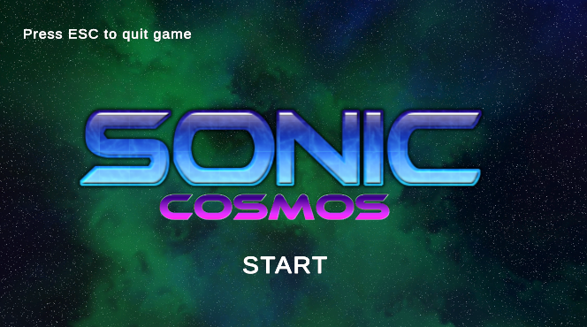
Main Menu

Slide 10
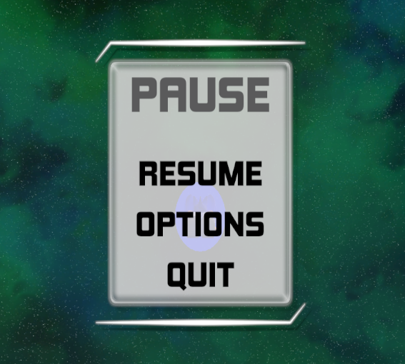
Pause Menu

Slide 11
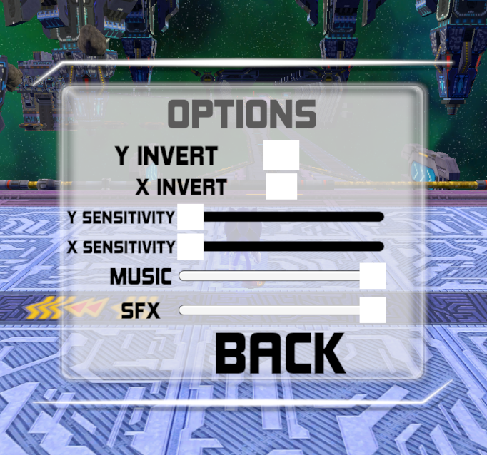
Options Menu

Slide 12
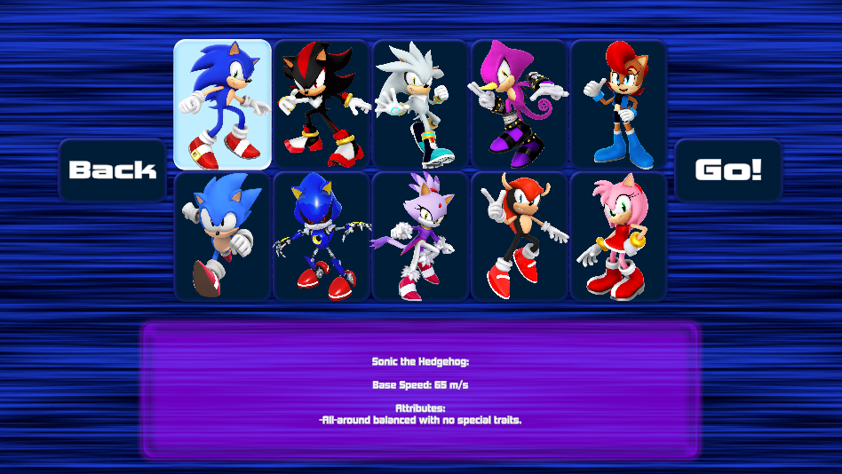
Character Select

Slide 13
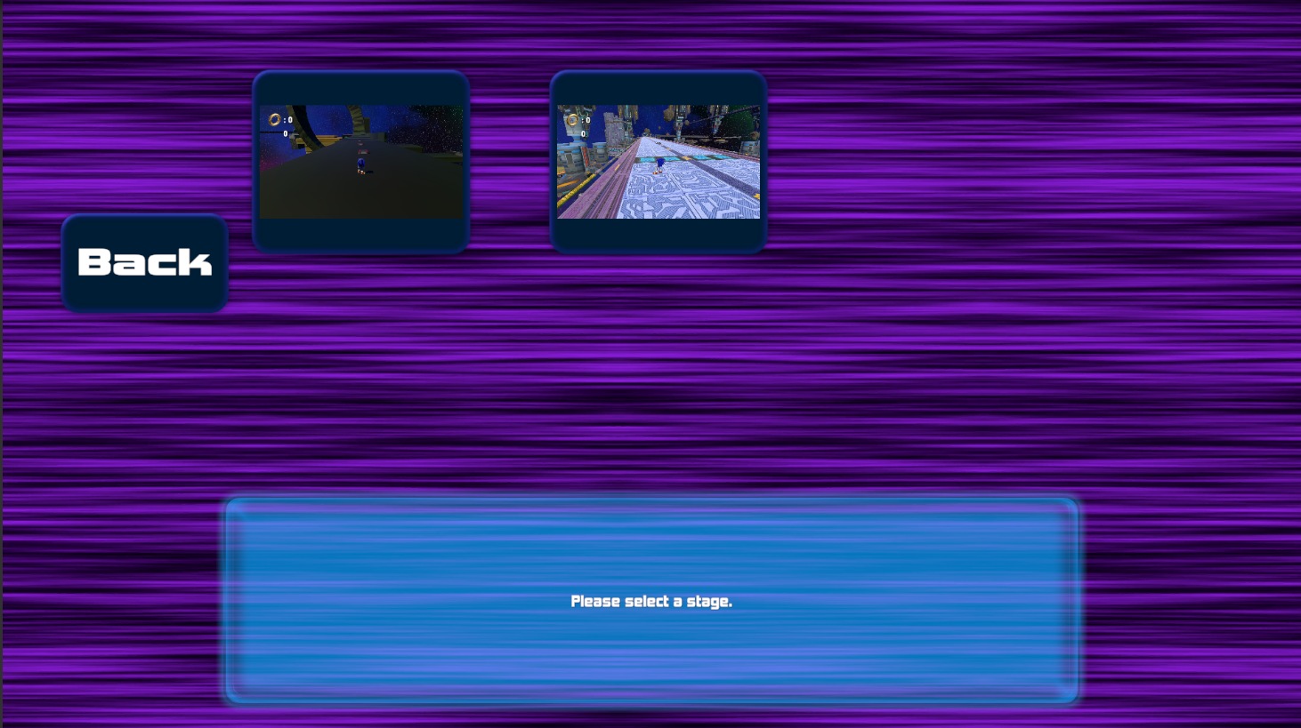
Stage Select

Slide 14

Stage Complete

Slide 15
Stages

Slide 16
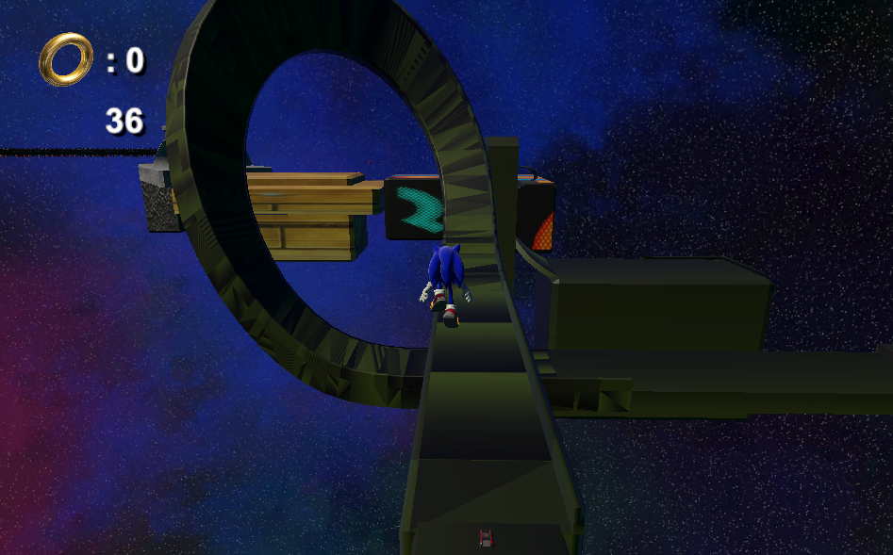
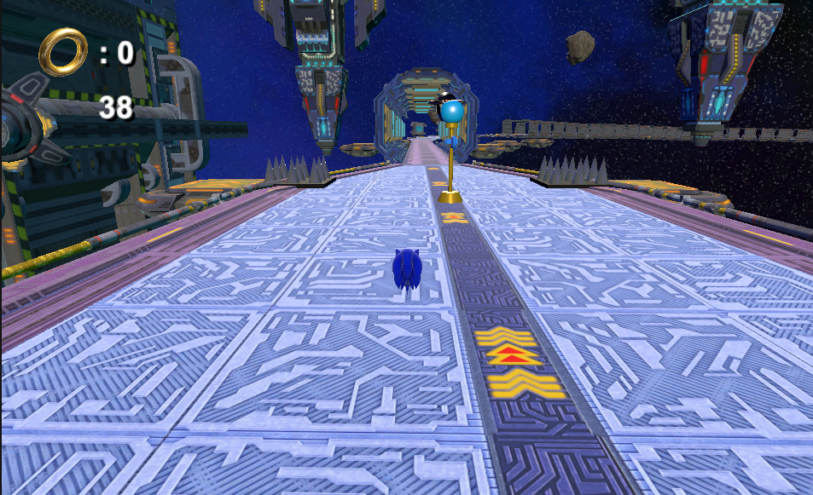
Stages (Levels)
Gameplay

Slide 17
Thank you for listening!

